Slide 1

Introduction to Operating Systems CS/COE 1550
Fall 2021
Sherif Khattab
ksm73@pitt.edu
(Some slides are from Silberschatz, Galvin and Gagne ©2013)

Slide 2
Announcements
Upcoming deadlines:
11/8: Lab 3
11/12: Homework 8
11/19: Project 3

Slide 3
Previous lecture …
Page Replacement Algorithms

Slide 4
Muddiest Points (1/2)
Why do we need various algorithms that seem to do the same thing? For example, why do we need both NFU and Aging when it seems the optimal algorithm would be them both combined together?
When would we use NFU vs NRU vs LRU?
does every page replacement algorithm require looking at all pages
How does the working set decide what to replace evicted pages with
Also a table or easy to consume breakdown of all the Lagos would be nice.
LRU
can you go over again what you said about the linked list having to be in hardware and why that's difficult to implement?
Why can’t you use a linked list to implement LRU
Can we review CPU cycle vs. clock cycle again
can we review simulating lru in software?
FIFO/Second Chance/CLOCK
In FIFO, what happens when a page is referenced but already in the linked-list? Is one removed or are there now 2 entries in the linked list?
What would happen if all clock pages had been accessed?
Does the clock hand advance after replacing a page?

Slide 5
Muddiest Points (2/2)
Working Set
How can WS be fast/ how its implemented?
How likely is it that we actually know the working set of a process?
What determines the time interval for defining the working set
We looked at working set page replacement from a perspective outside of processes, but has anyone suggested a coding paradigm where developers try to create programs that have working sets of a set size so that the working set is very predictable?
what does the shift register do to be exact
Aging
Could you go over how aging algorithm works again?

Slide 6
Today …
Tracing Page Replacement Algorithms

Slide 7
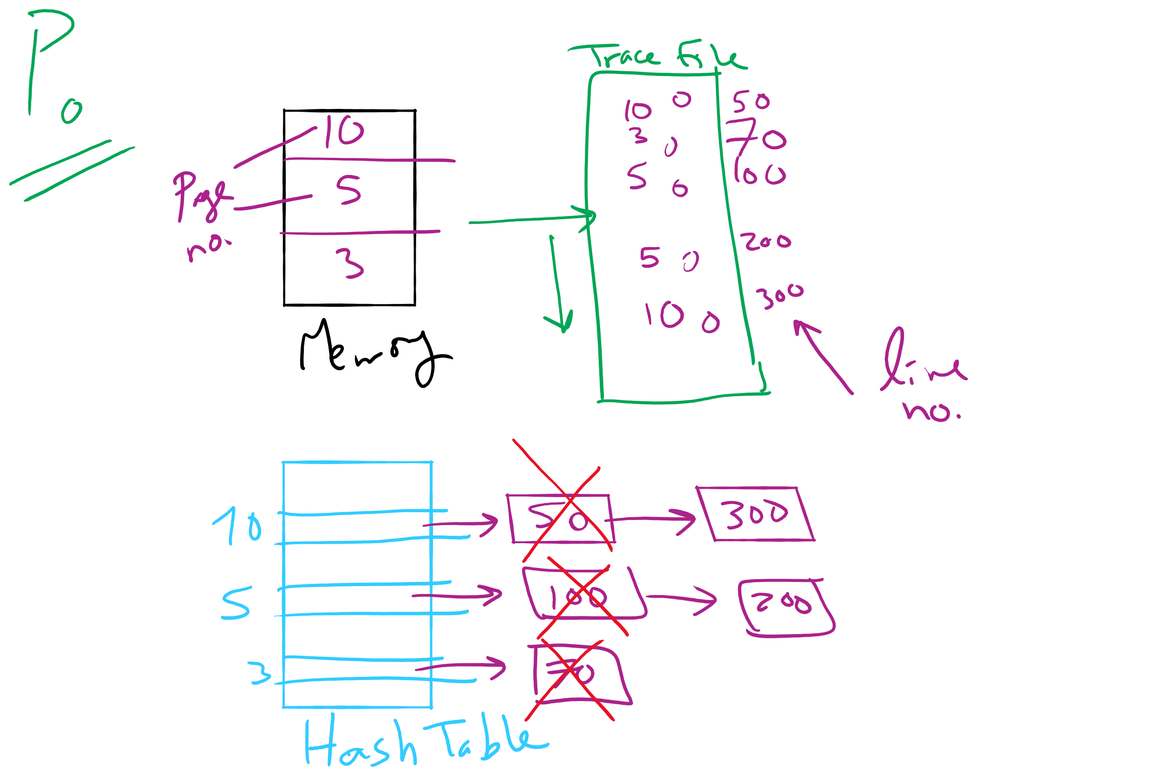
Project 3: OPT Simulation

Slide 8
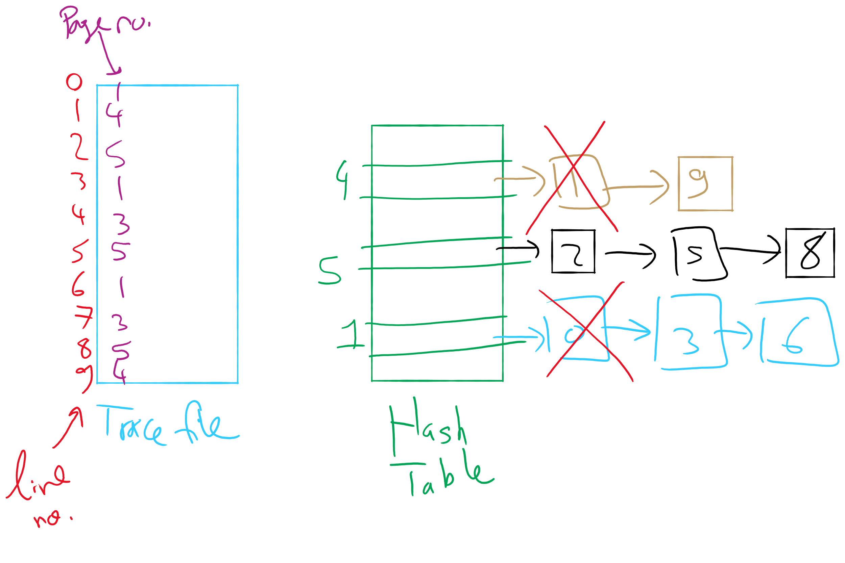
OPT Implementation Example

Slide 9

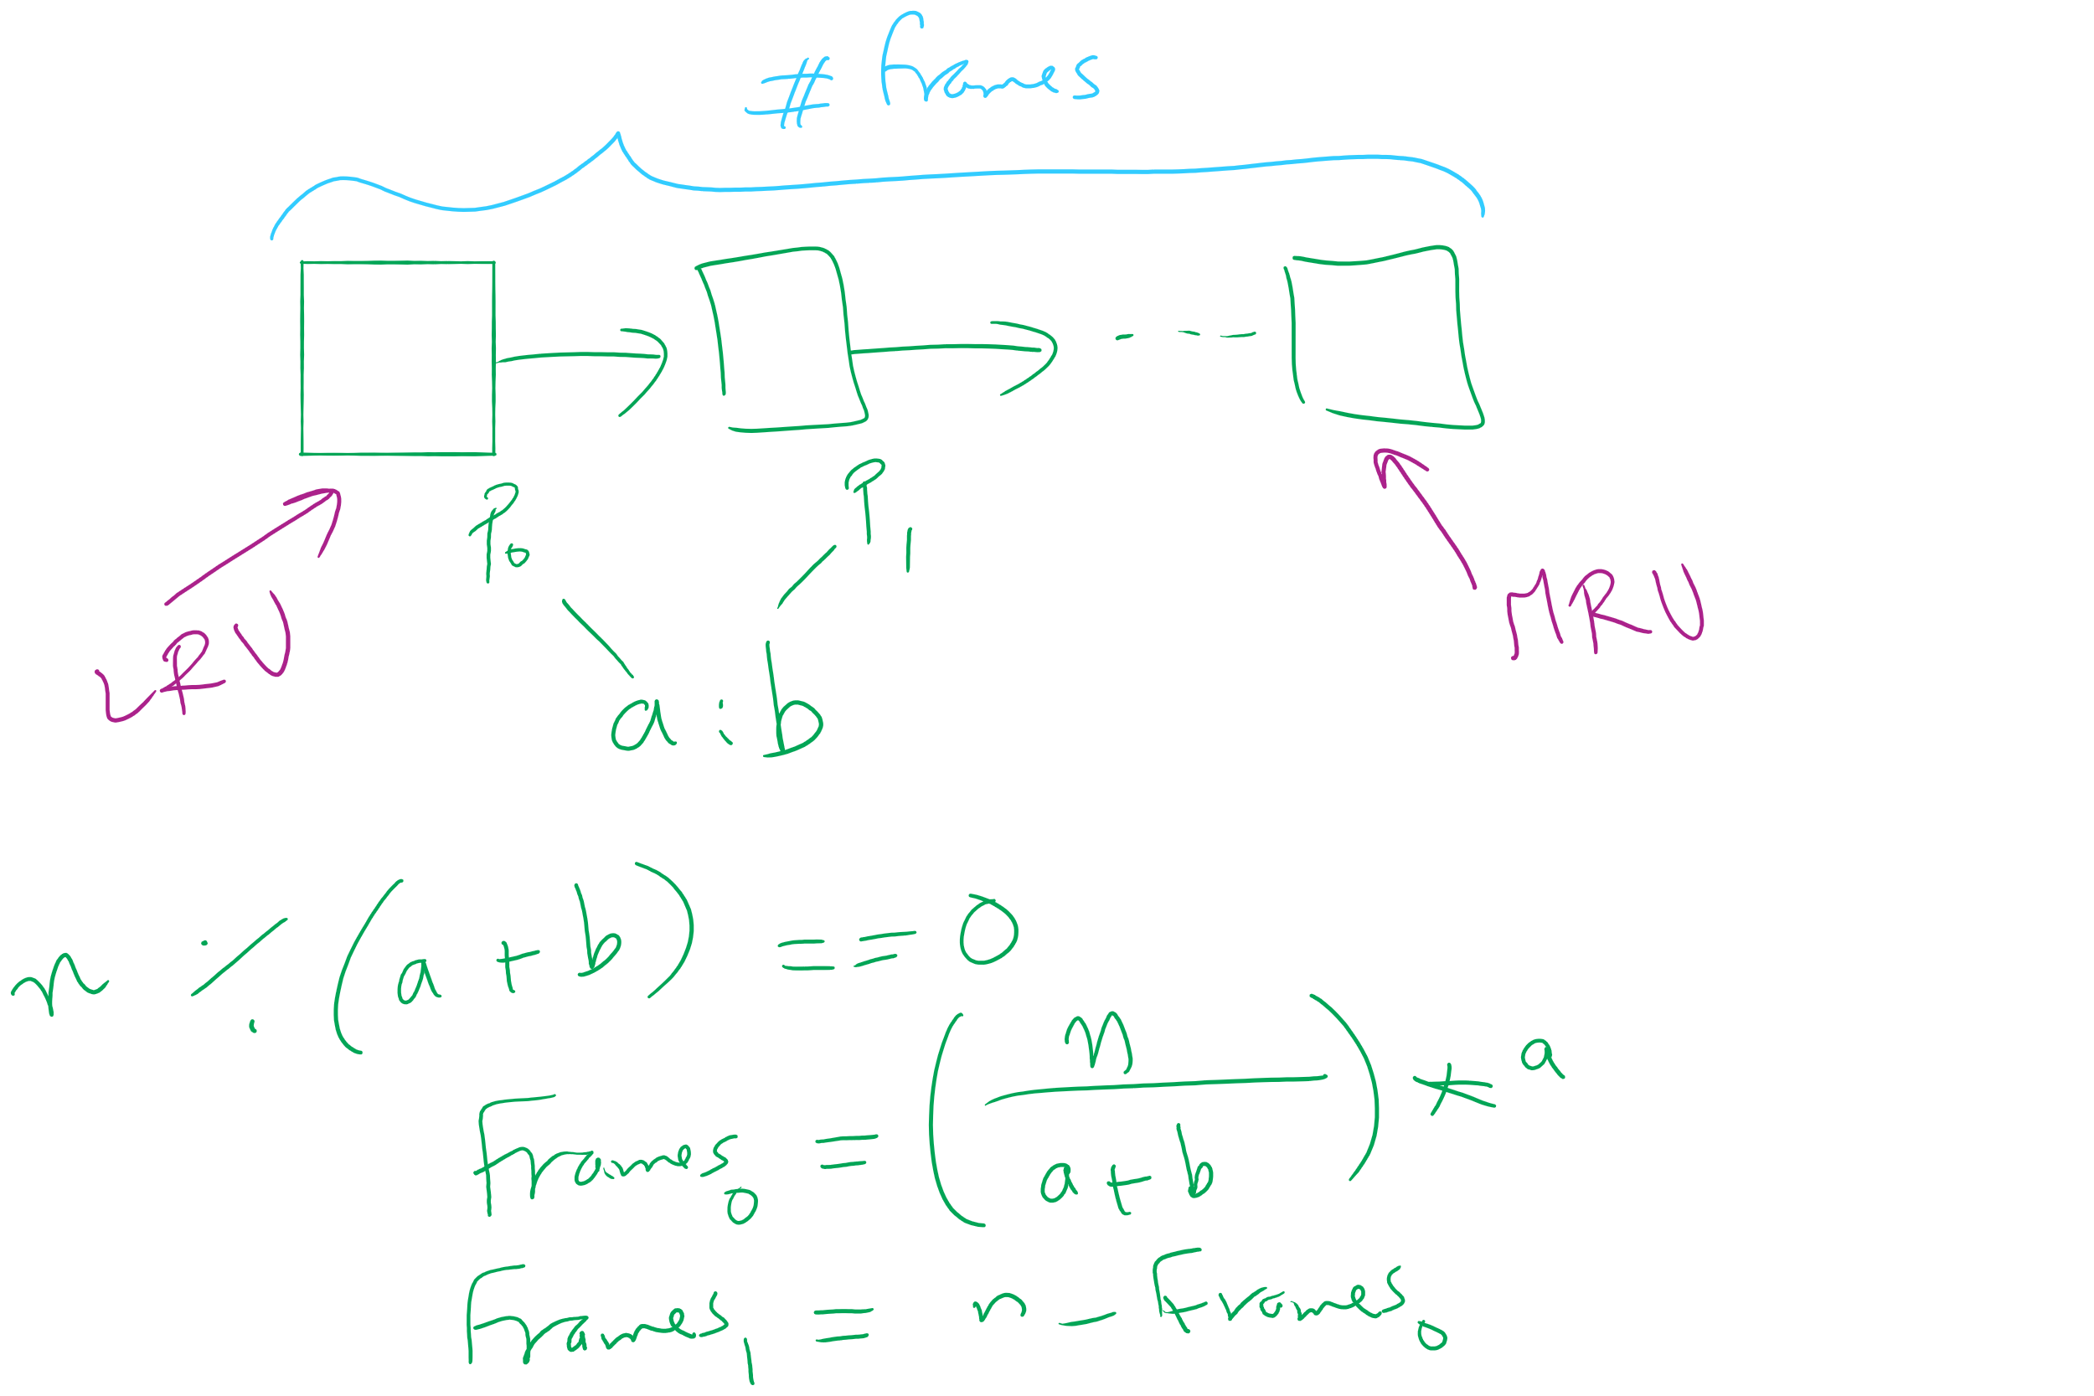
Project 3: LRU and miscellaneous hints

Slide 10
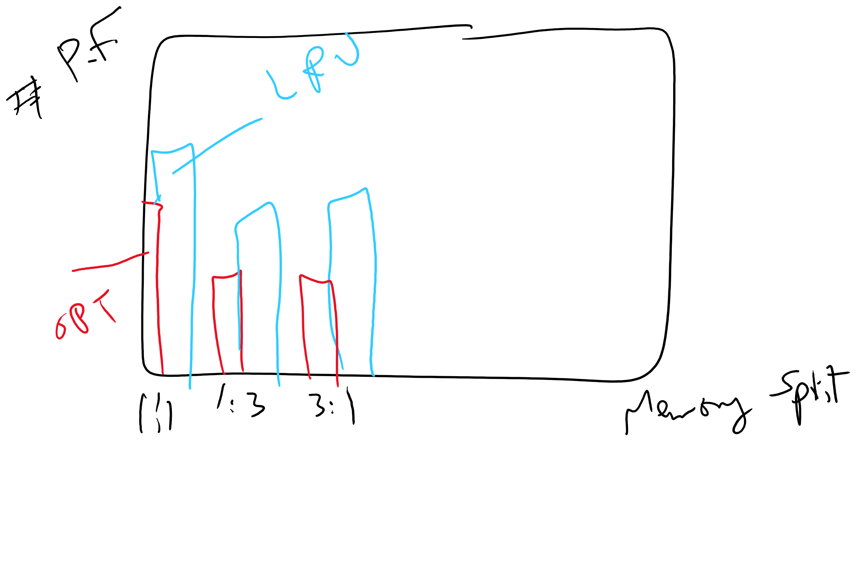
Project 3: Writeup hints

Slide 11
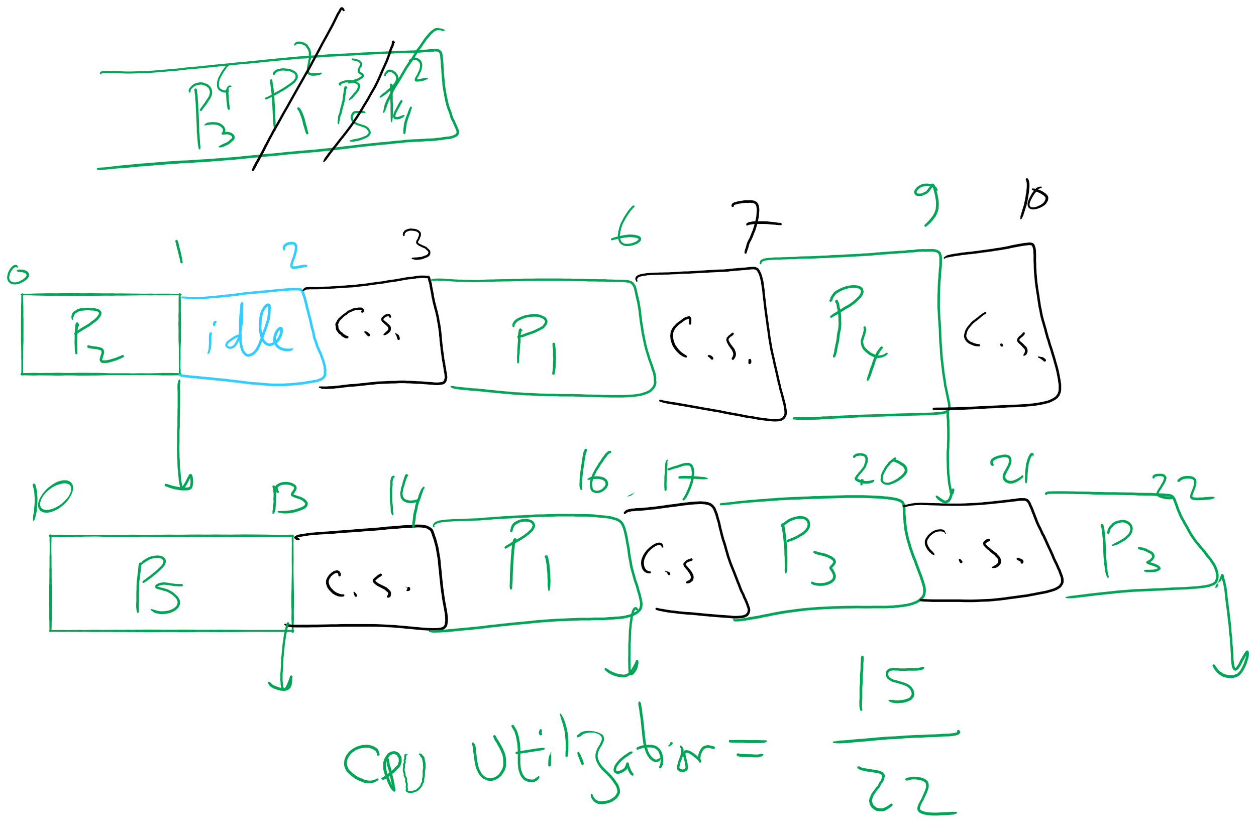
Q18,19 in HW7

Slide 12
Working set
Demand paging: bring a page into memory when it’s requested by the process
How many pages are needed?
Could be all of them, but not likely
Instead, processes reference a small set of pages at any given time—locality of reference
Set of pages can be different for different processes or even different times in the running of a single process
Set of pages used by a process in a given interval of time is called the working set
If entire working set is in memory, no page faults!
If insufficient space for working set, thrashing may occur
Goal: keep most of working set in memory to minimize the number of page faults suffered by a process

Slide 13
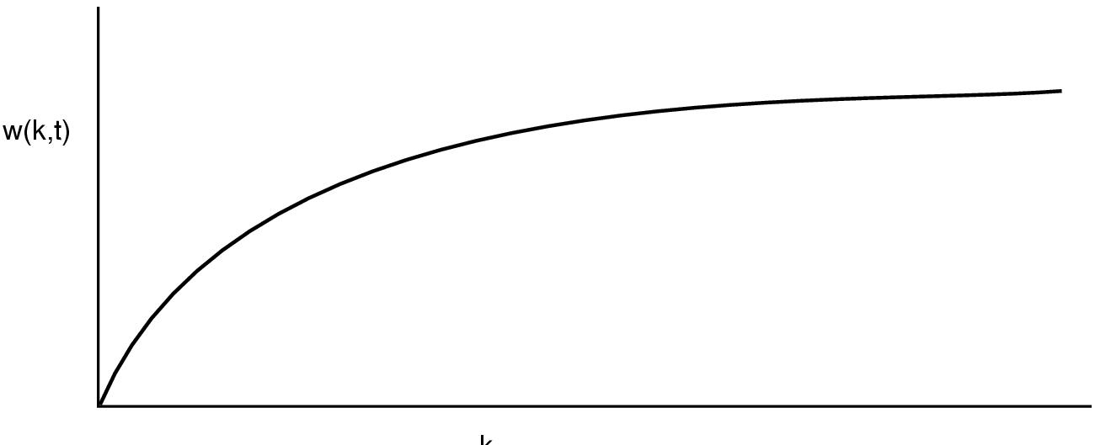
How big is the working set?
w(k,t)
k
Working set is the set of pages used by the k most recent memory references
w(k,t) is the size of the working set at time t
Working set may change over time
Size of working set can change over time as well…

Slide 14
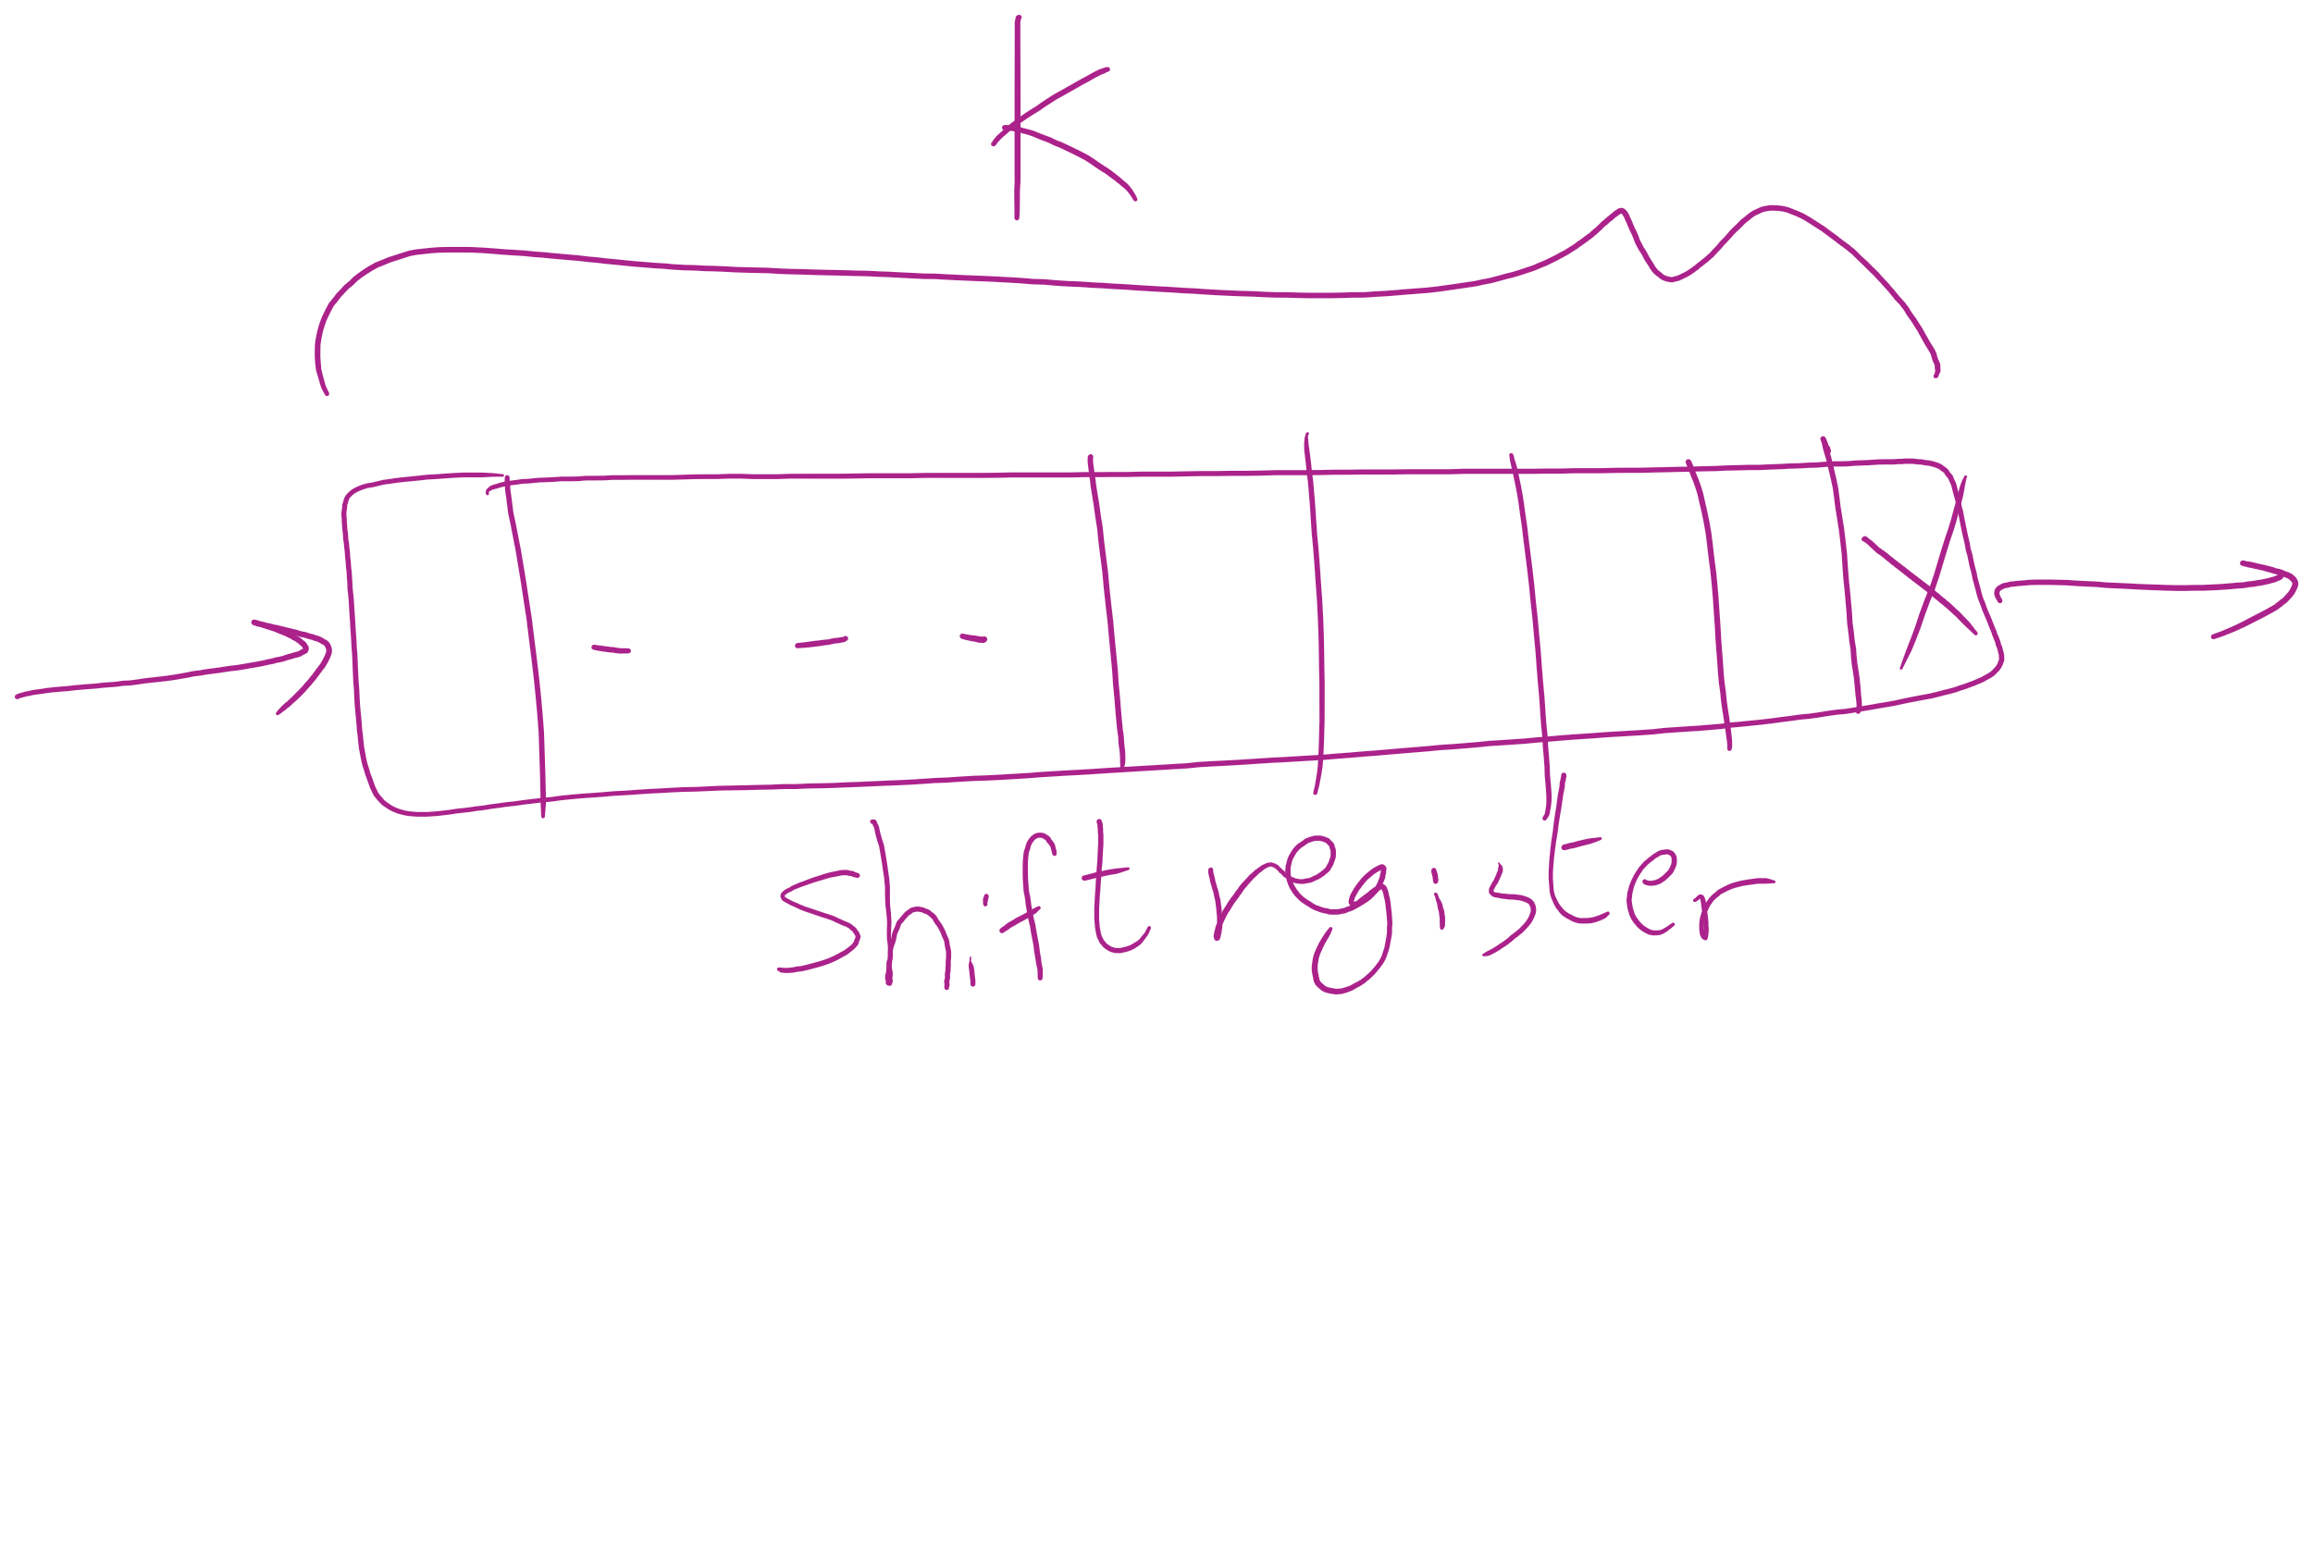
Keeping track of the Working Set

Slide 15
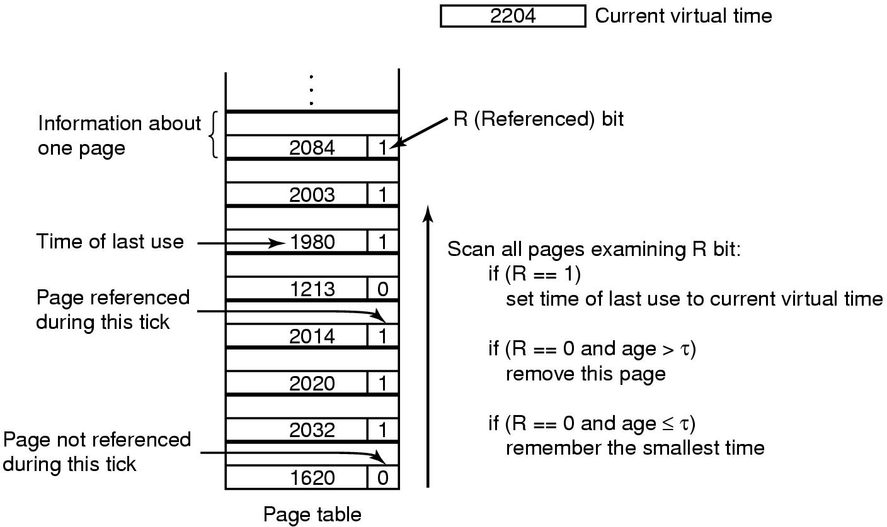
Working set page replacement algorithm

Slide 16
Page replacement algorithms: summary
Algorithm | Comment
OPT (Optimal) | Not implementable, but useful as a benchmark
NRU (Not Recently Used) | Crude
FIFO (First-In, First Out) | Might throw out useful pages
Second chance | Big improvement over FIFO
Clock | Better implementation of second chance
LRU (Least Recently Used) | Excellent, but hard to implement exactly
NFU (Not Frequently Used) | Poor approximation to LRU
Aging | Good approximation to LRU, efficient to implement
Working Set | Somewhat expensive to implement
WSClock | Implementable version of Working Set

Slide 17
Modeling page replacement algorithms
Goal: provide quantitative analysis (or simulation) showing which algorithms do better
Workload (page reference string) is important: different strings may favor different algorithms
Show tradeoffs between algorithms
Compare algorithms to one another
Model parameters within an algorithm
Number of available physical pages
Number of bits for aging

Slide 18
How is modeling done?
Generate a list of references
Artificial (made up)
Trace a real workload (set of processes)
Use an array (or other structure) to track the pages in physical memory at any given time
May keep other information per page to help simulate the algorithm (modification time, time when paged in, etc.)
Run through references, applying the replacement algorithm
Example: FIFO replacement on reference string 0 1 2 3 0 1 4 0 1 2 3 4
Page replacements highlighted in yellow
Page referenced |  | 0 | 1 | 2 | 3 | 0 | 1 | 4 | 0 | 1 | 2 | 3 | 4
Youngest page |  | 0 | 1 | 2 | 3 | 0 | 1 | 4 | 4 | 4 | 2 | 3 | 3
 |  |  | 0 | 1 | 2 | 3 | 0 | 1 | 1 | 1 | 4 | 2 | 2
Oldest page |  |  |  | 0 | 1 | 2 | 3 | 0 | 0 | 0 | 1 | 4 | 4

Slide 19
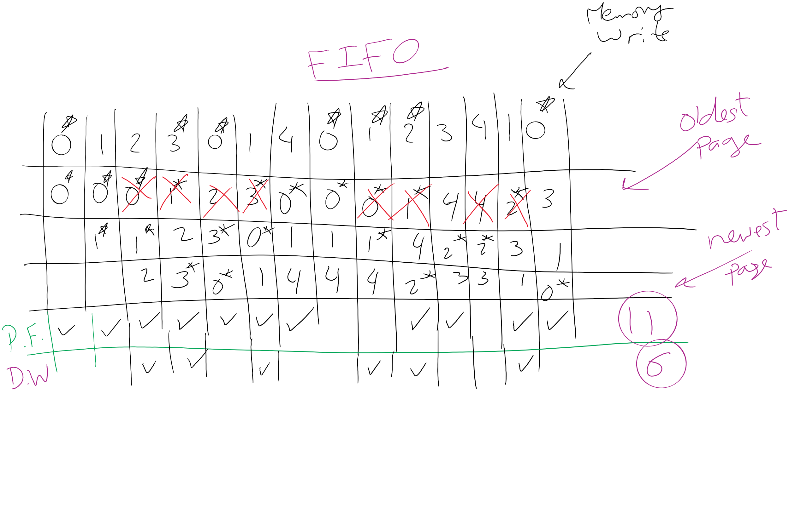
FIFO Example 1

Slide 20
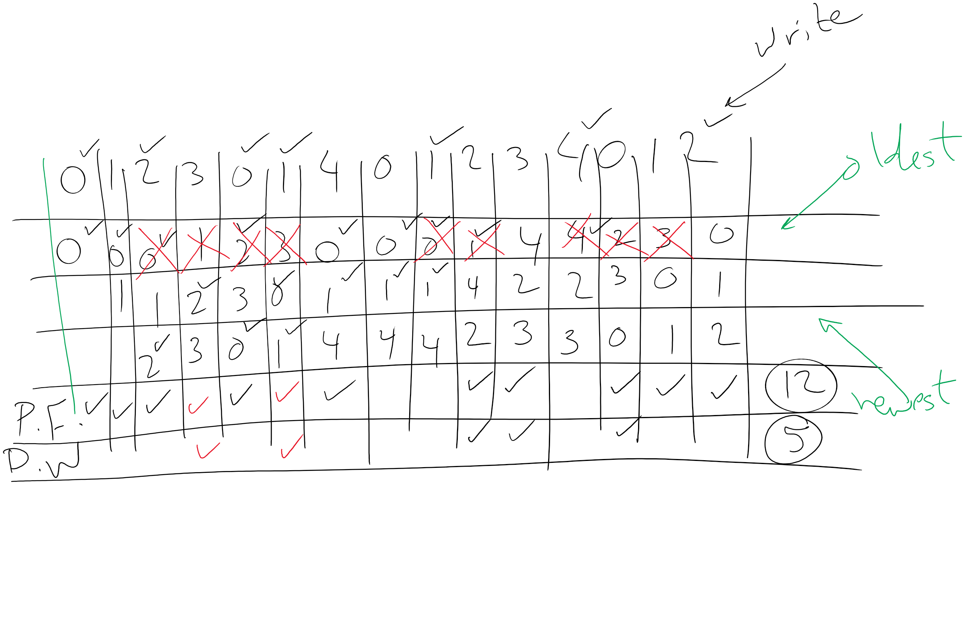
FIFO Example 2

Slide 21
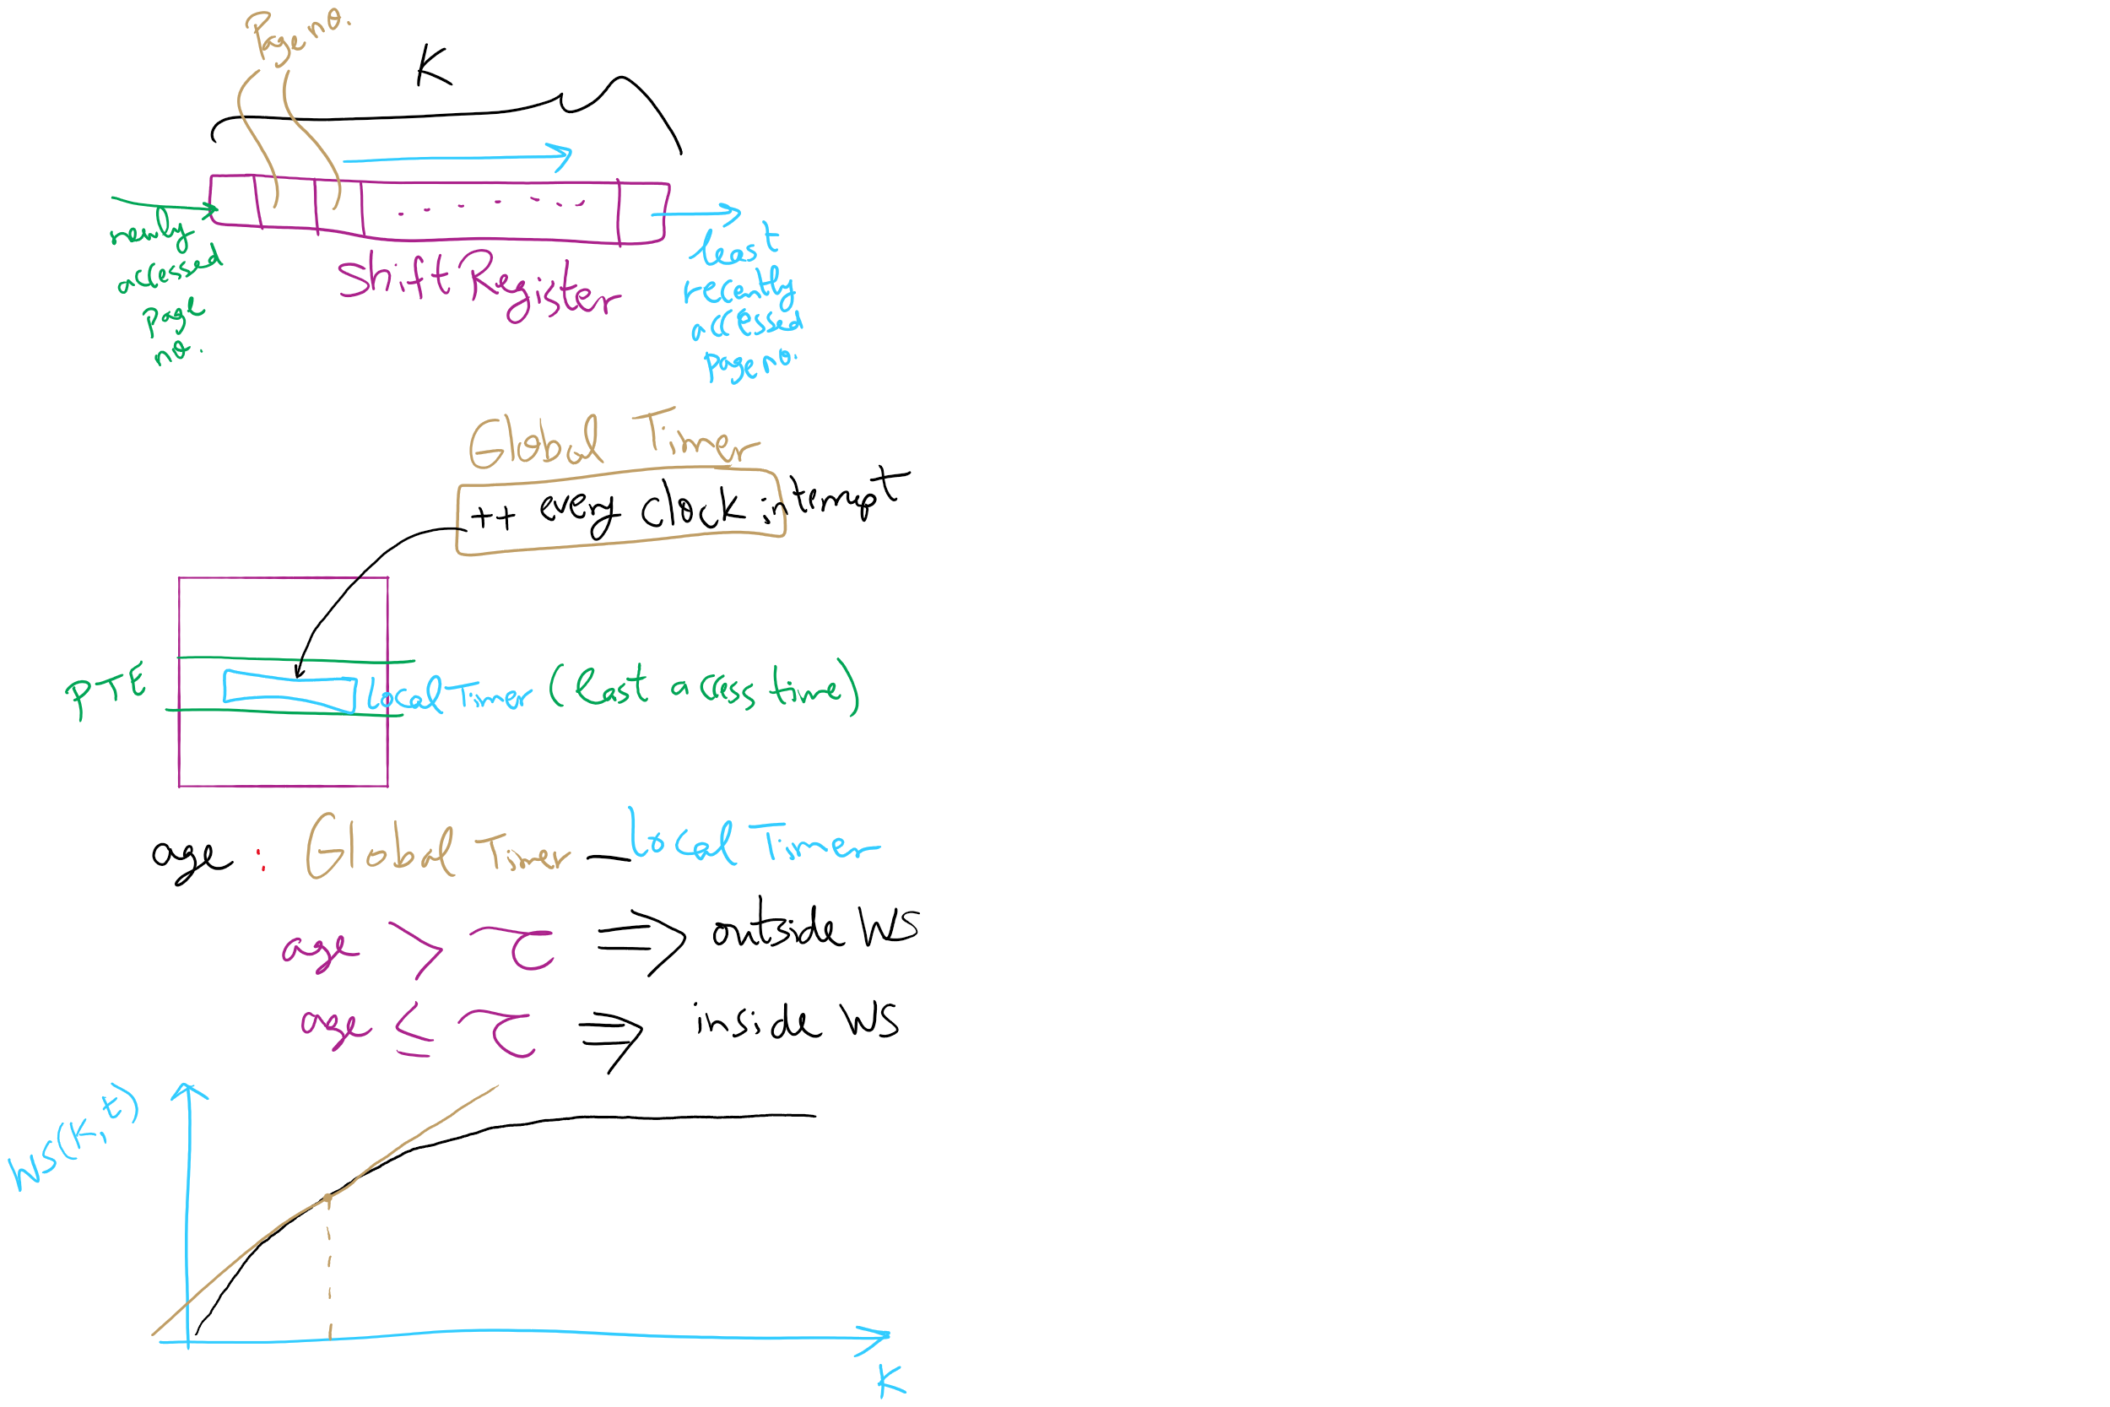
Working Set Algorithm

Slide 22
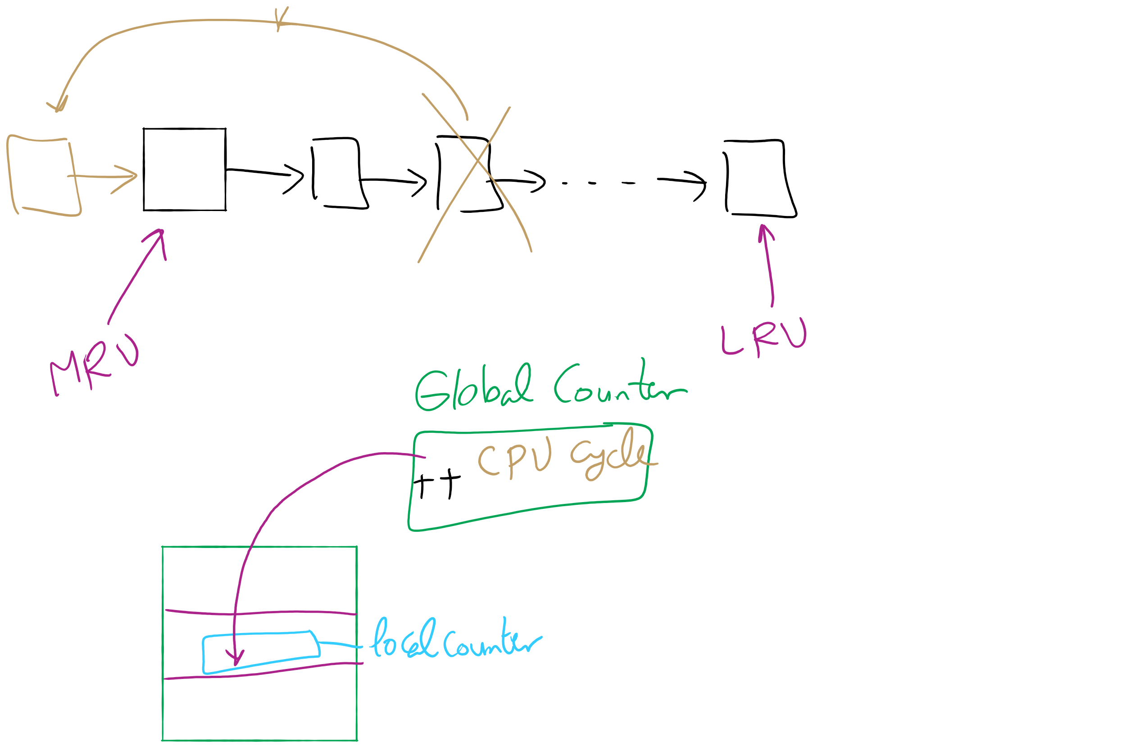
LRU

Slide 23
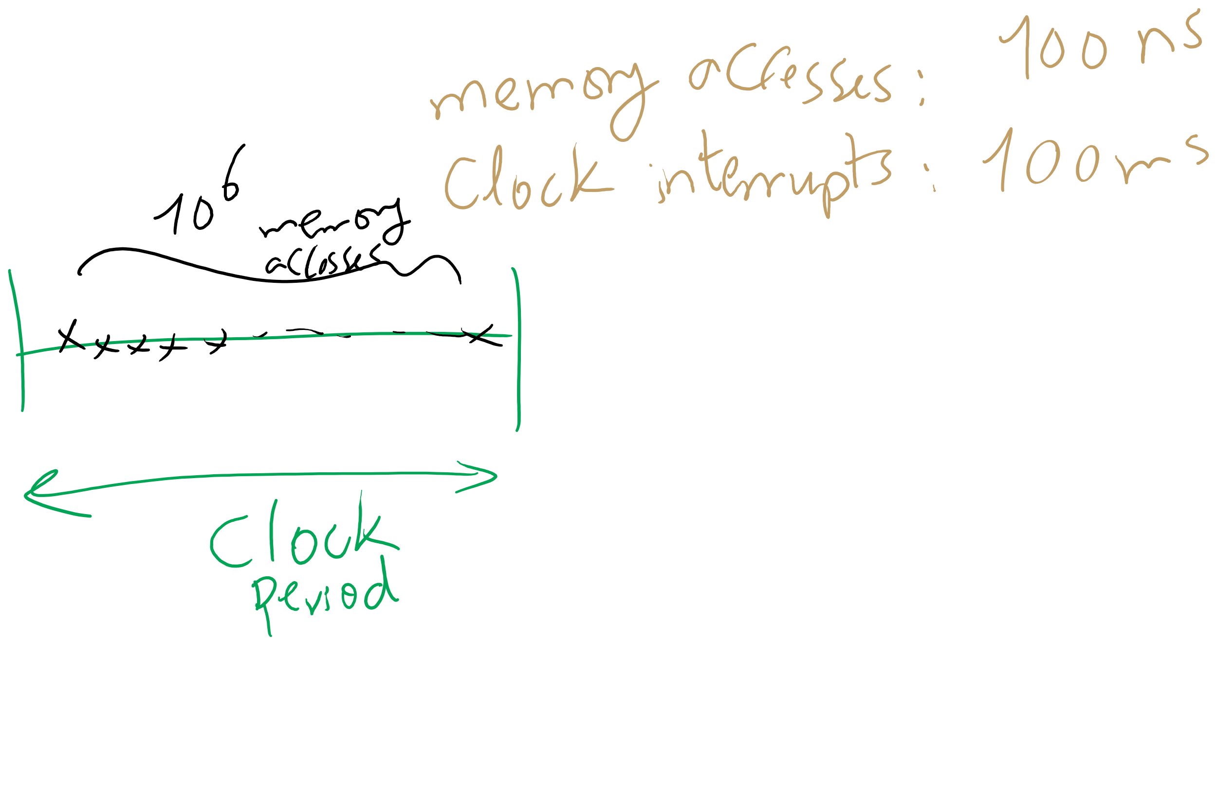
NFU

Slide 24
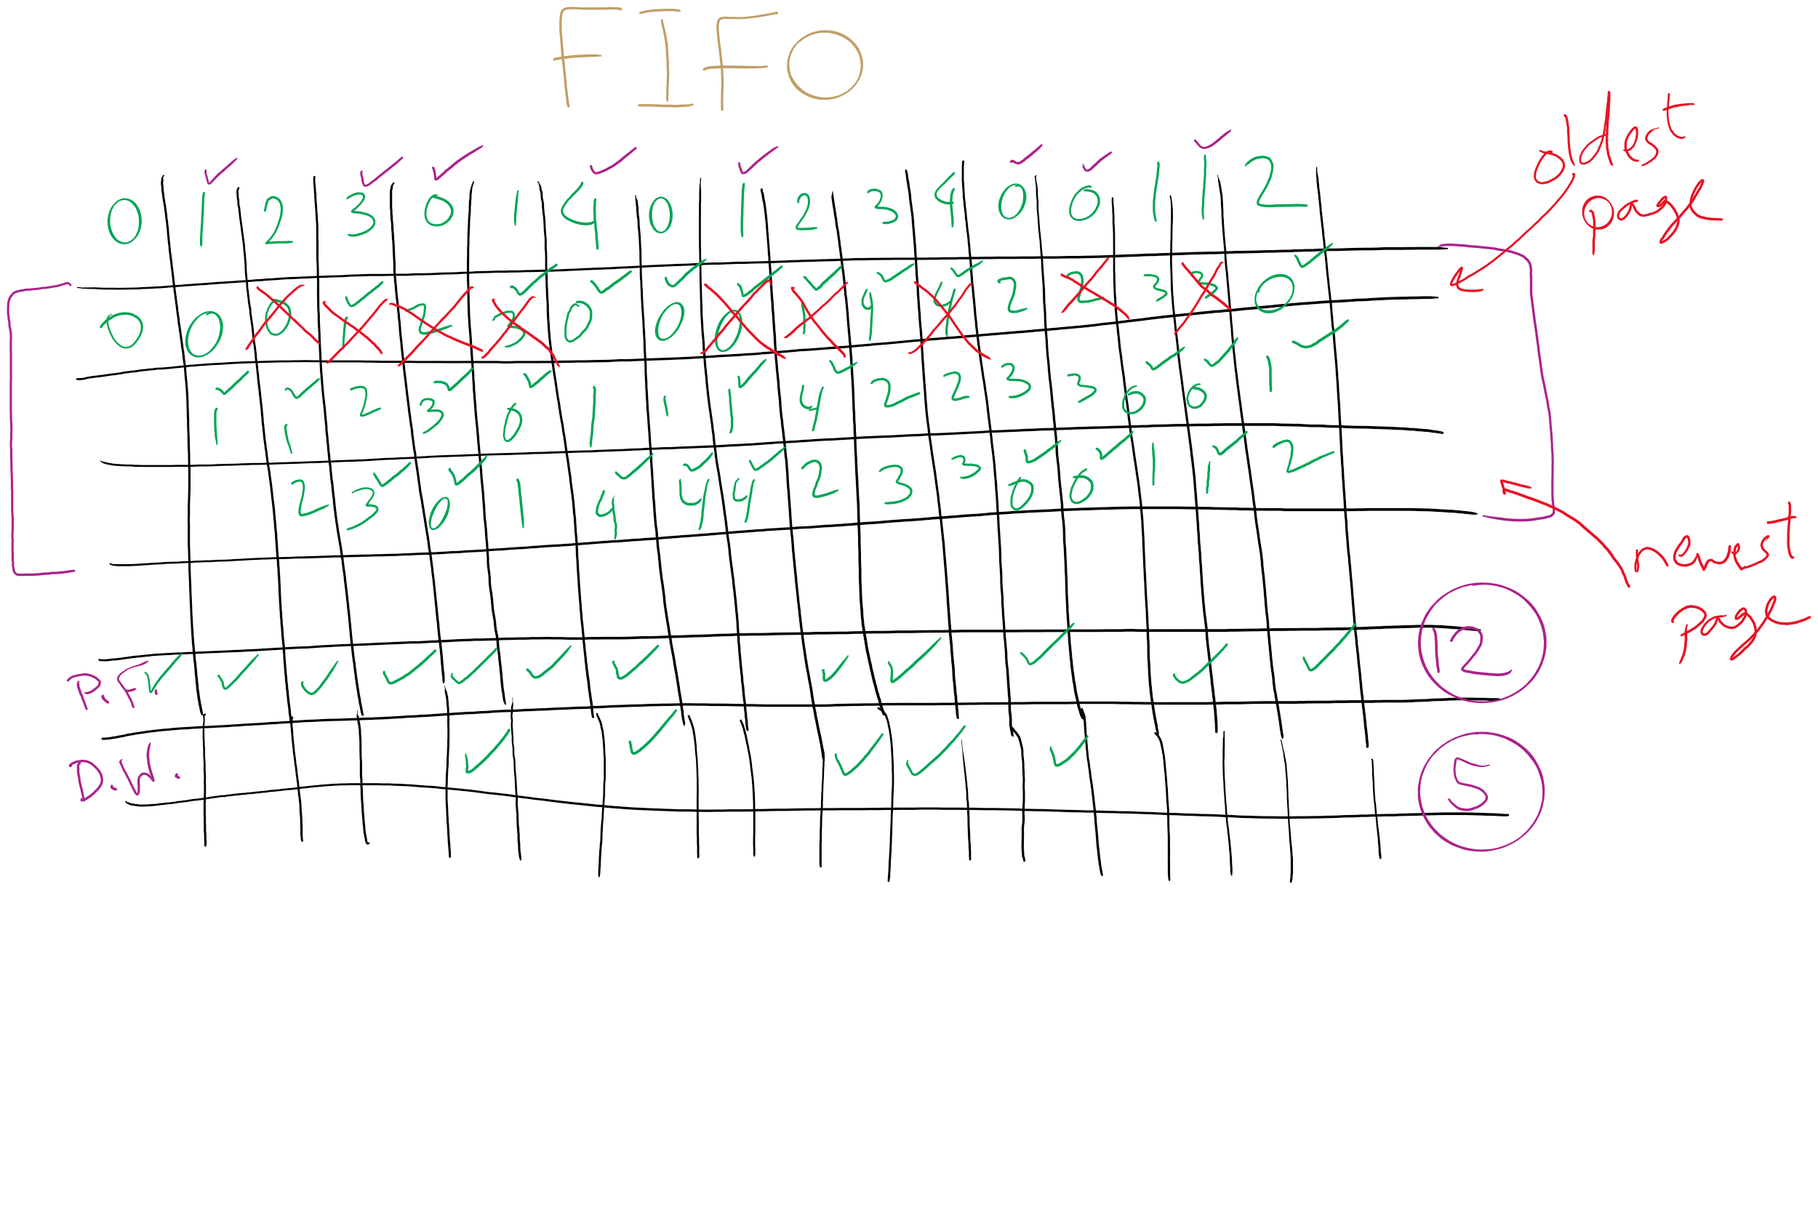
FIFO with 3 frames

Slide 25
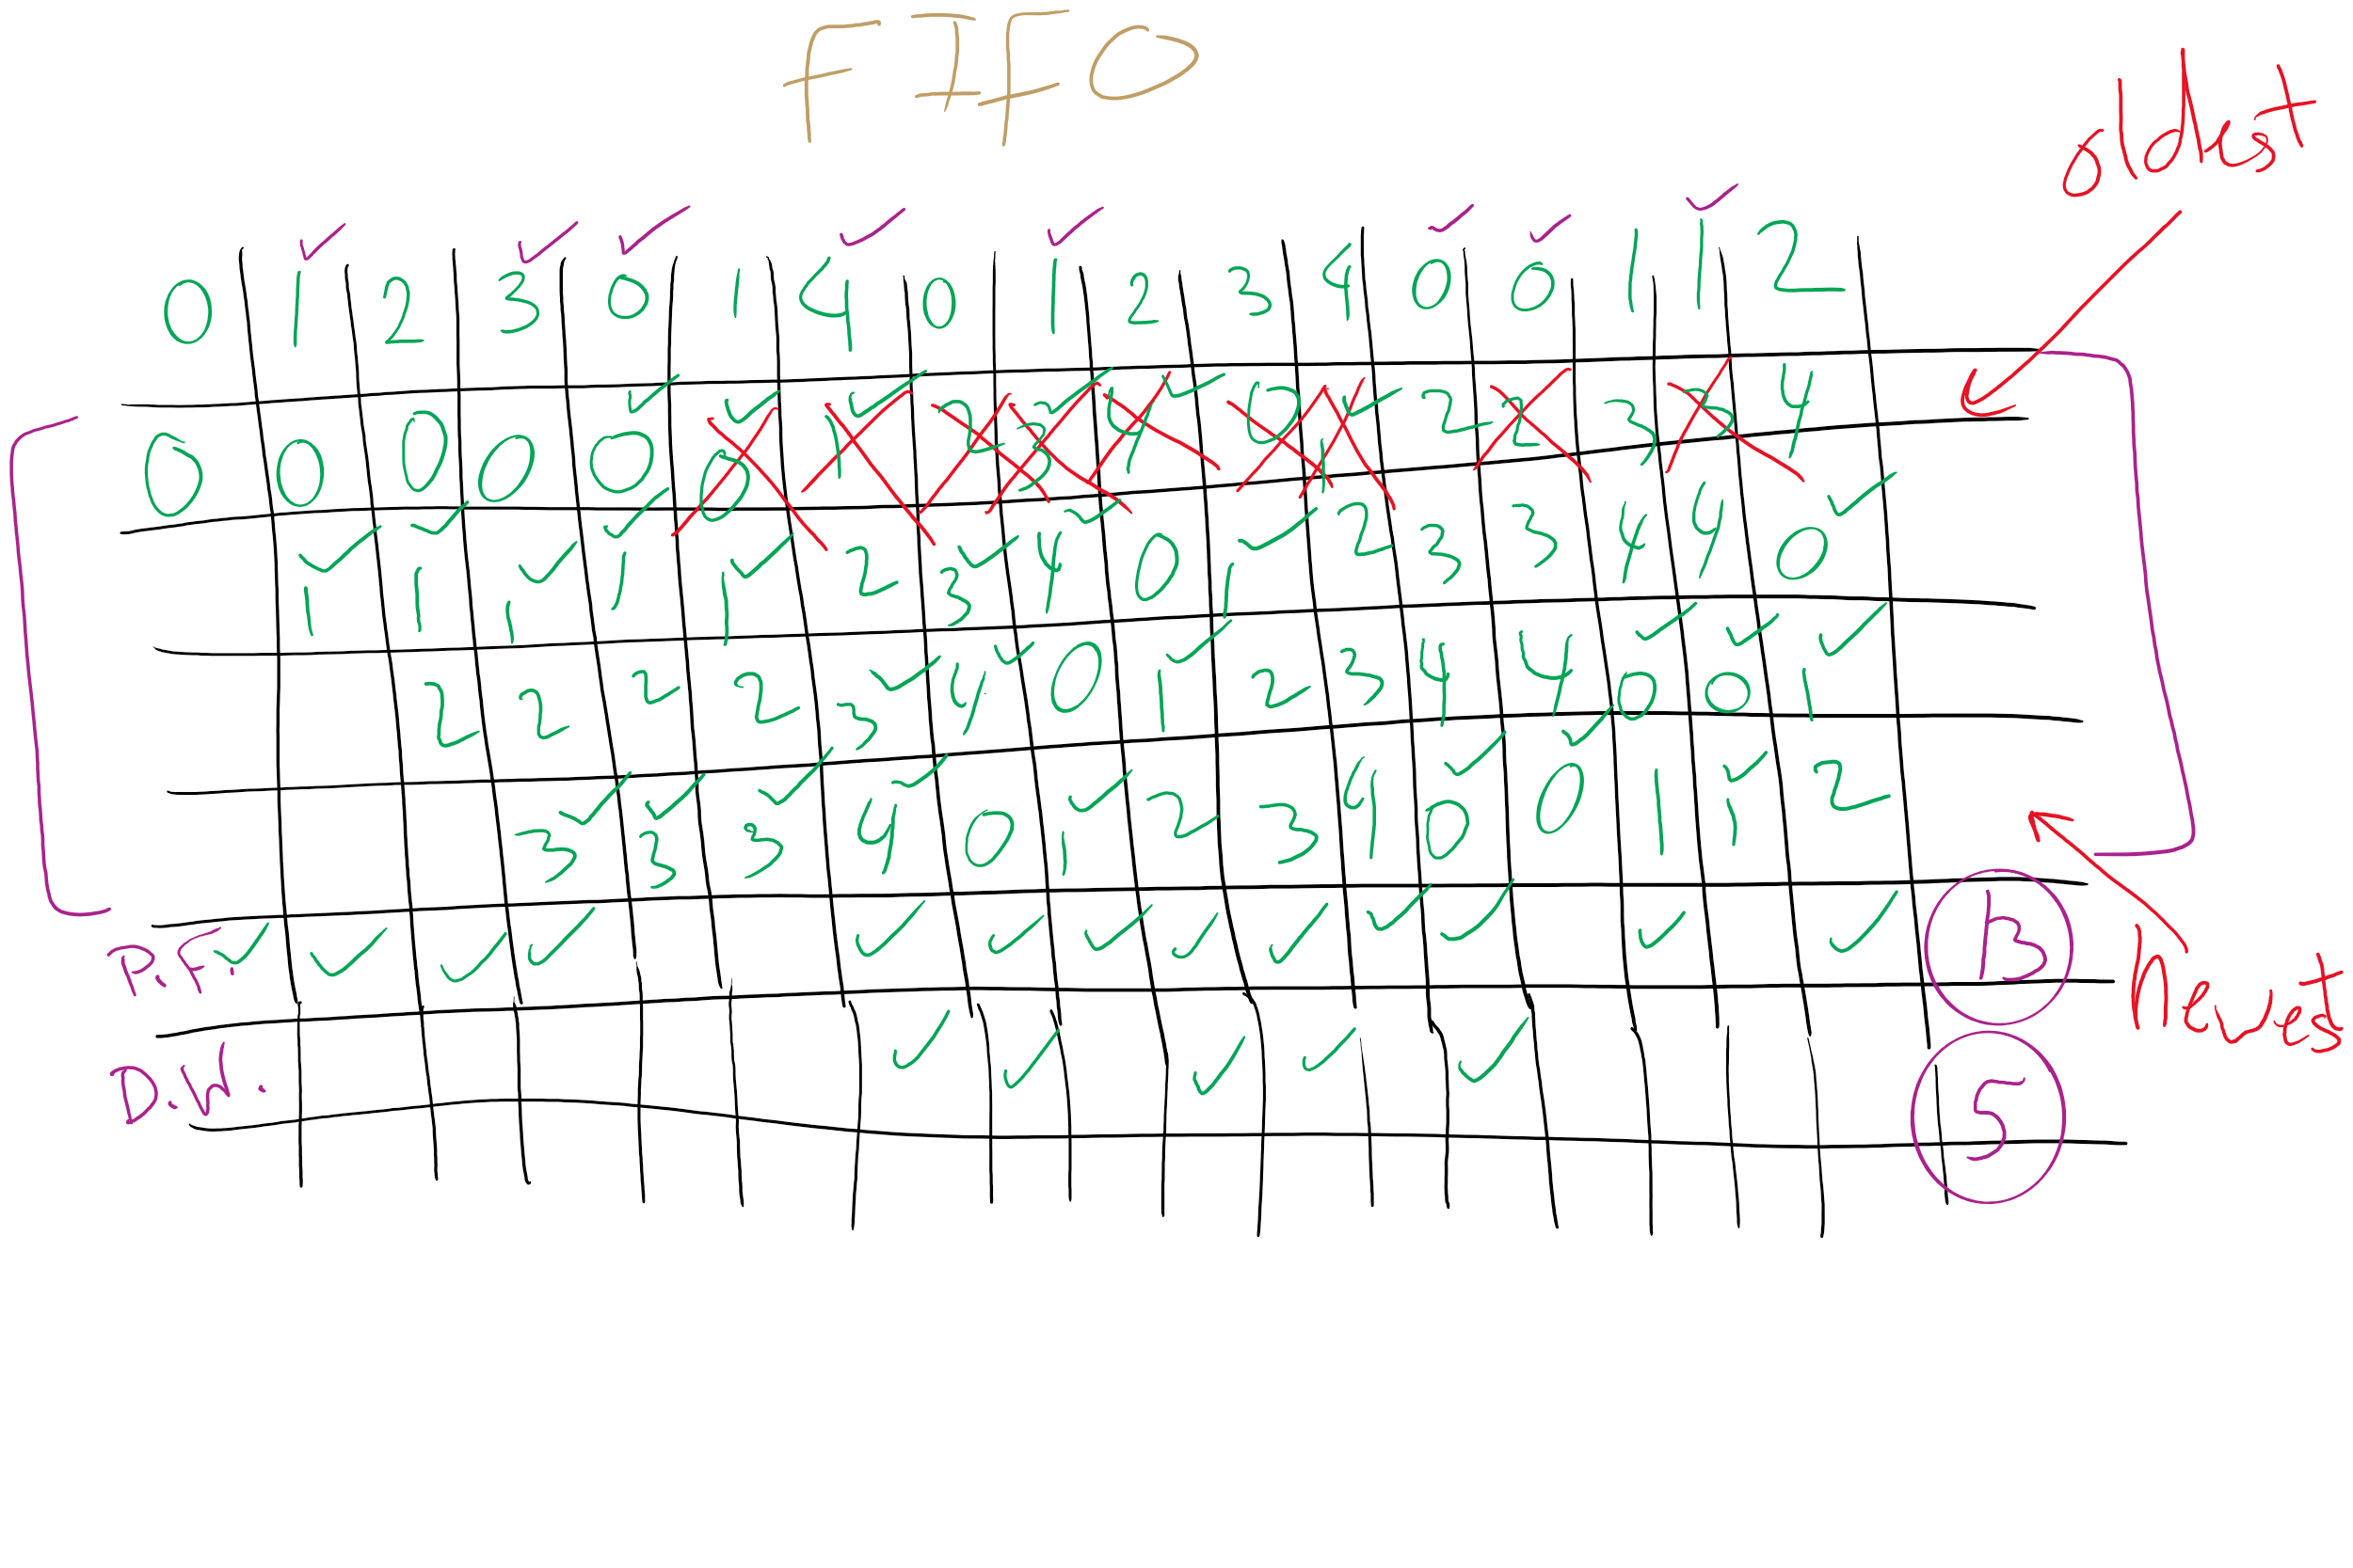
FIFO with 4 frames

Slide 26
Belady’s anomaly
Reduce the number of page faults by supplying more memory
Use previous reference string and FIFO algorithm
Add another page to physical memory (total 4 pages)
More page faults (10 vs. 9), not fewer!
This is called Belady’s anomaly
Adding more pages shouldn’t result in worse performance!
Motivated the study of paging algorithms
Page referenced |  | 0 | 1 | 2 | 3 | 0 | 1 | 4 | 0 | 1 | 2 | 3 | 4
Youngest page |  | 0 | 1 | 2 | 3 | 3 | 3 | 4 | 0 | 1 | 2 | 3 | 4
 |  |  | 0 | 1 | 2 | 2 | 2 | 3 | 4 | 0 | 1 | 2 | 3
 |  |  |  | 0 | 1 | 1 | 1 | 2 | 3 | 4 | 0 | 1 | 2
Oldest page |  |  |  |  | 0 | 0 | 0 | 1 | 2 | 3 | 4 | 0 | 1

Slide 27
Modeling more replacement algorithms
Paging system characterized by:
Reference string of executing process
Page replacement algorithm
Number of page frames available in physical memory (m)
Model this by keeping track of all n pages referenced in array M
Top part of M has m pages in memory
Bottom part of M has n-m pages stored on disk
Page replacement occurs when page moves from top to bottom
Top and bottom parts may be rearranged without causing movement between memory and disk

Slide 28
Example: LRU
Model LRU replacement with
8 unique references in the reference string
4 pages of physical memory
Array state over time shown below
LRU treats list of pages like a stack
 | 0 | 2 | 1 | 3 | 5 | 4 | 6 | 3 | 7 | 4 | 7 | 3 | 3 | 5 | 5 | 3 | 1 | 1 | 1 | 7 | 1 | 3 | 4 | 1
 | 0 | 2 | 1 | 3 | 5 | 4 | 6 | 3 | 7 | 4 | 7 | 3 | 3 | 5 | 5 | 3 | 1 | 1 | 1 | 7 | 1 | 3 | 4 | 1
 |  | 0 | 2 | 1 | 3 | 5 | 4 | 6 | 3 | 7 | 4 | 7 | 7 | 3 | 3 | 5 | 3 | 3 | 3 | 1 | 7 | 1 | 3 | 4
 |  |  | 0 | 2 | 1 | 3 | 5 | 4 | 6 | 3 | 3 | 4 | 4 | 7 | 7 | 7 | 5 | 5 | 5 | 3 | 3 | 7 | 1 | 3
 |  |  |  | 0 | 2 | 1 | 3 | 5 | 4 | 6 | 6 | 6 | 6 | 4 | 4 | 4 | 7 | 7 | 7 | 5 | 5 | 5 | 7 | 7
 |  |  |  |  | 0 | 2 | 1 | 1 | 5 | 5 | 5 | 5 | 5 | 6 | 6 | 6 | 4 | 4 | 4 | 4 | 4 | 4 | 5 | 5
 |  |  |  |  |  | 0 | 2 | 2 | 1 | 1 | 1 | 1 | 1 | 1 | 1 | 1 | 6 | 6 | 6 | 6 | 6 | 6 | 6 | 6
 |  |  |  |  |  |  | 0 | 0 | 2 | 2 | 2 | 2 | 2 | 2 | 2 | 2 | 2 | 2 | 2 | 2 | 2 | 2 | 2 | 2
 |  |  |  |  |  |  |  |  | 0 | 0 | 0 | 0 | 0 | 0 | 0 | 0 | 0 | 0 | 0 | 0 | 0 | 0 | 0 | 0

Slide 29
Stack algorithms
LRU is an example of a stack algorithm
For stack algorithms
Any page in memory with m physical pages is also in memory with m+1 physical pages
Increasing memory size is guaranteed to reduce (or at least not increase) the number of page faults
Stack algorithms do not suffer from Belady’s anomaly
Distance of a reference == position of the page in the stack before the reference was made
Distance is ∞ if no reference had been made before
Distance depends on reference string and paging algorithm: might be different for LRU and optimal (both stack algorithms)

Slide 30
Predicting page fault rates using distance
Distance can be used to predict page fault rates
Make a single pass over the reference string to generate the distance string on-the-fly
Keep an array of counts
Entry j counts the number of times distance j occurs in the distance string
The number of page faults for a memory of size m is the sum of the counts for j>m
This can be done in a single pass!
Makes for fast simulations of page replacement algorithms
This is why virtual memory theorists like stack algorithms!

